Slide 1
BARTENDER
Senior Design Project
By: Calum Siemer, Evan Airey, Elise Winkley, Peyton Leuck

Slide 2
01
INTRODUCTION

Slide 3
Spring Goals
Our goal was to continue to develop our web-application into a fully functional and aesthetically pleasing website with a variety of features that would help our users connect to managers and private events. This includes a chat system, location services, rating system, etc.

Slide 4
Design

Slide 5
Domains & Subdomains
employees
bartender
managers
www.employees.bartender.work
www.bartender.work
www.managers.bartender.work
Pick up Bartending gig work and shifts
Check your
work schedule
Work history
Total Earnings
Ratings
Live chat with Managers
Landing Page
Add your Restaurant, Bar, or Private Event
Create Schedules and Shifts for Bartenders
Leave Bartenders Ratings
Live chat with Bartenders
API
www.api.bartender.work
The endpoint for all HTTP requests
CRUD

Slide 6
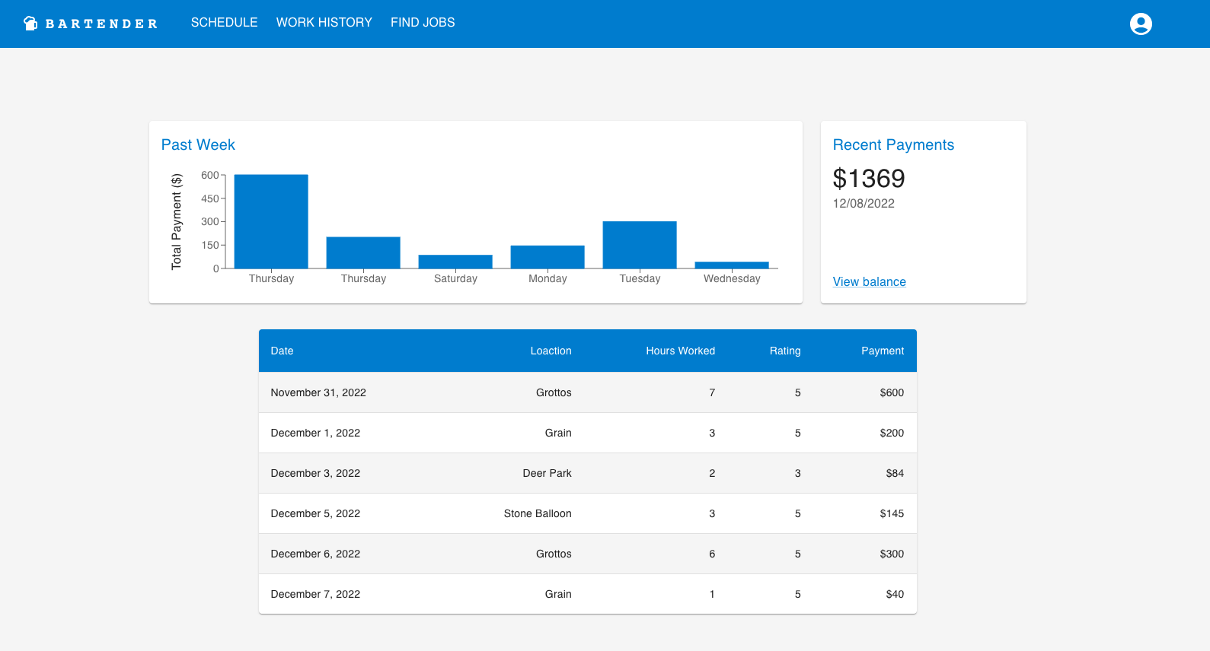
ReDesign From Fall

Slide 7
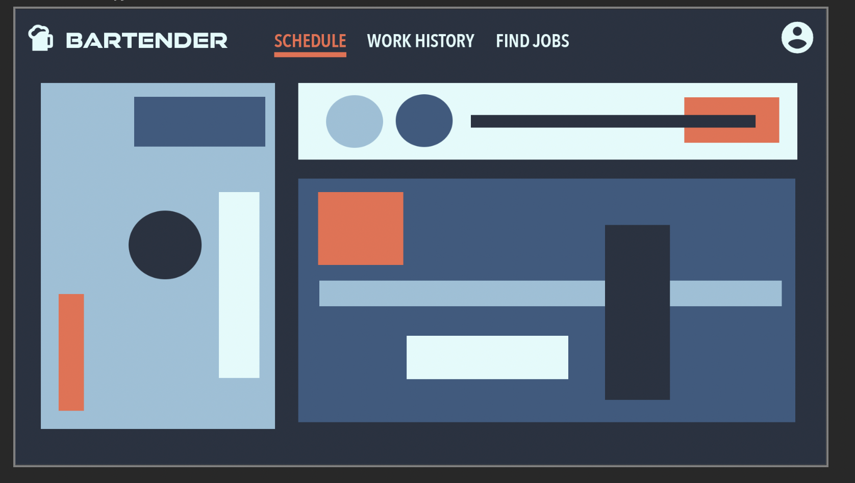

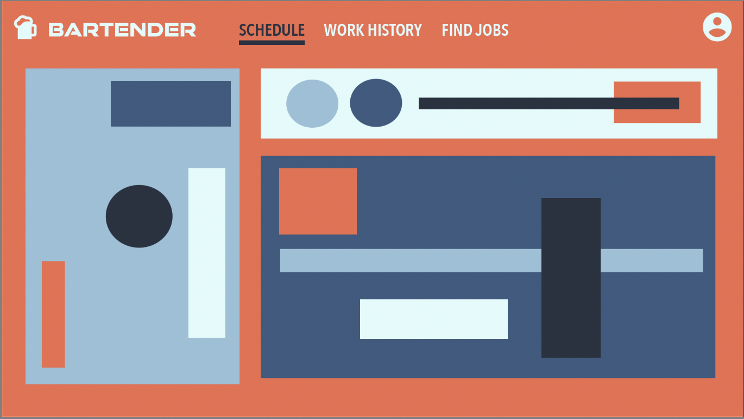
Starting With WireFrames
Manager UI design
Bartender UI design

Slide 8
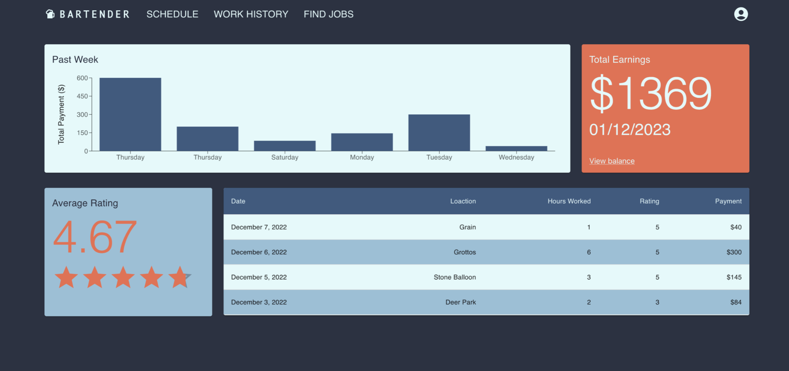
How it translated
This semester we learned a lot about
CSS (Cascading Style Sheets)
In-line styling with React Components

Slide 9
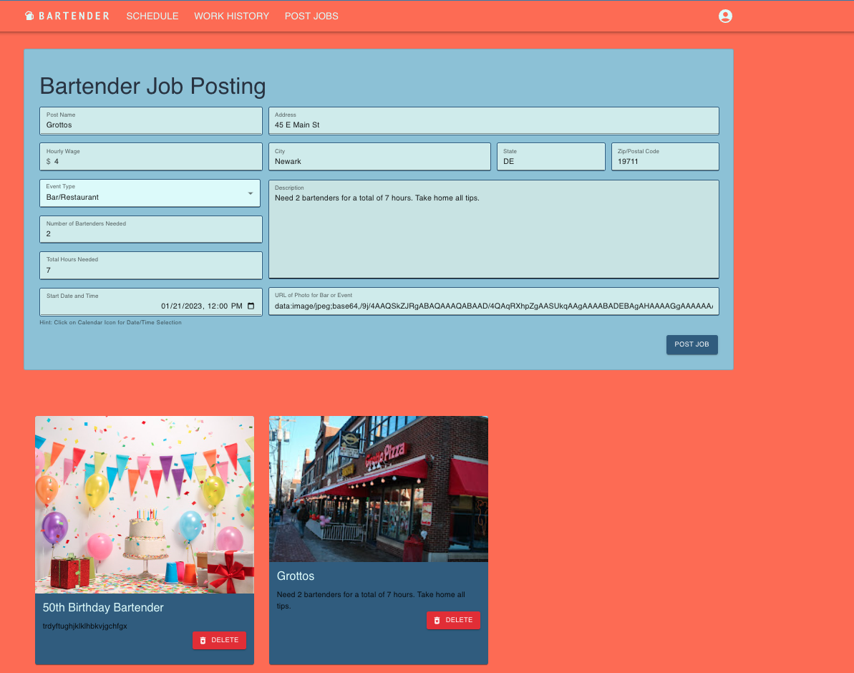
Creating Job Postings
Managers can enter in the following information to create
Post Name
Hourly Wage
Event Type
Number of Bartenders Needed
Total Hours of Work Needed
Start Date & Time
Address
Description
Photo

Slide 10
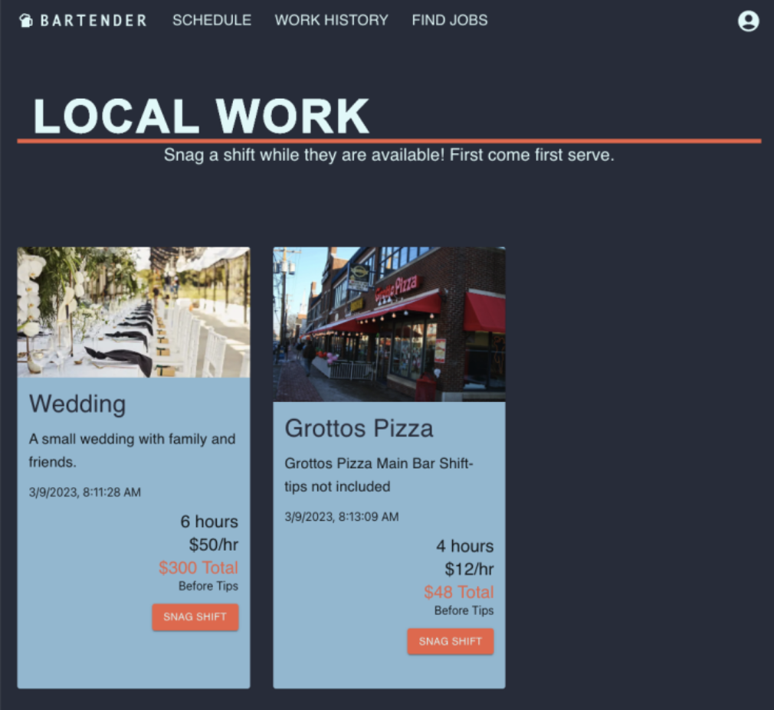
Snagging Job Postings
Bartenders can click on the snag shift button to put the shift into their calendar and begin chatting with the manager. If they need to cancel, the snag shift button changes its state to say “Cancel”

Slide 11
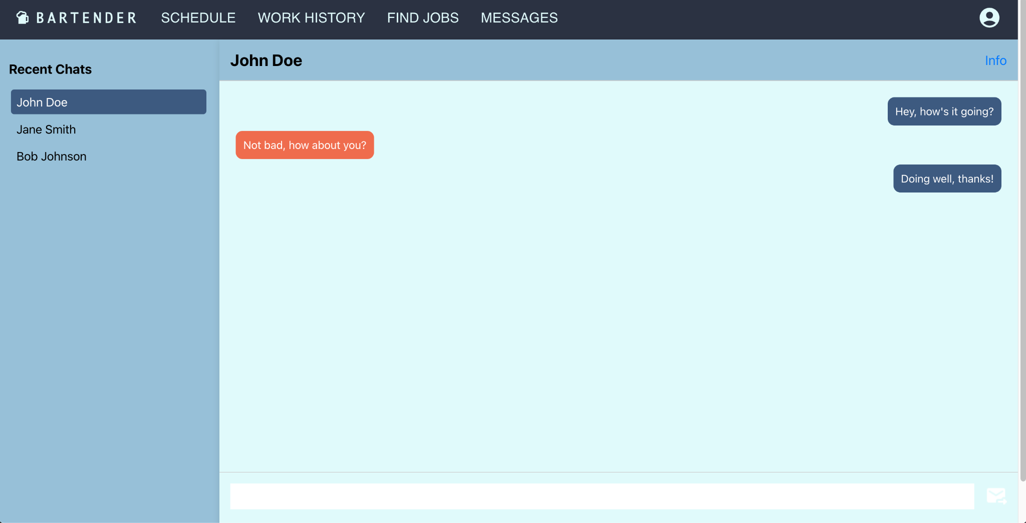
Chat System
Real Time Communication between bartenders and managers

Slide 12
Our Backend
CRUD
Tables in the Database
Create
Read
Update
Delete
users
user_id
username
password
create_time
snagged_shift
snag_id
post_id
manager_id
bartender_id
manager_post
post_id
manager_id
user_id
photo_url
description
address
hours
event_type
hourly_wage
post_name
num_bartenders
bartenders
date_time
entry_time
work_history
shift_id
bartender_id
hours_worked
rating
location
date
amount
entry_time
SQLite
Small
Fast
Self-contained
bartenders
bartender_id
user_id
first_name
last_name
address
phone_number
email
profile_pic
entry_time
mangers
manager_id
user_id
first_name
last_name
address
phone_number
email
profile_pic
subscription_type
entry_time
chat
thread_id
manager_id
bartender_id
message
sender

Slide 13

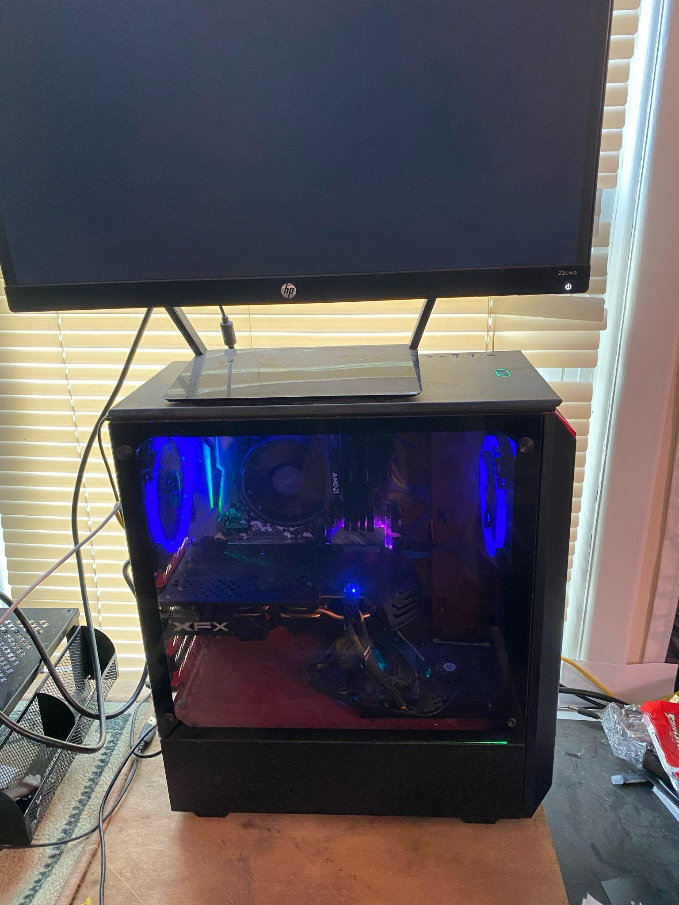



Hosting

Slide 14



Technologies Used
Axios
Python
React JS
Api calls from the frontend to the backend
SQLite backend database connection
Component based programing

Slide 15



Technologies Used
GitLab
OpenCage
Leaflet
Repository for all our
apps
JS program for getting
longitude and latitude
Free Map API

Slide 16

CONCEPT
Our Senior Design project is to create a webpage that links bars, restaurants or private events with bartenders in the local area.

Slide 17
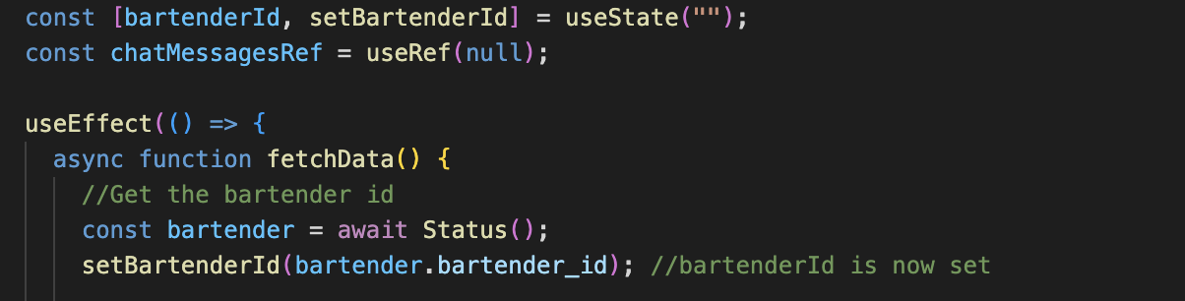
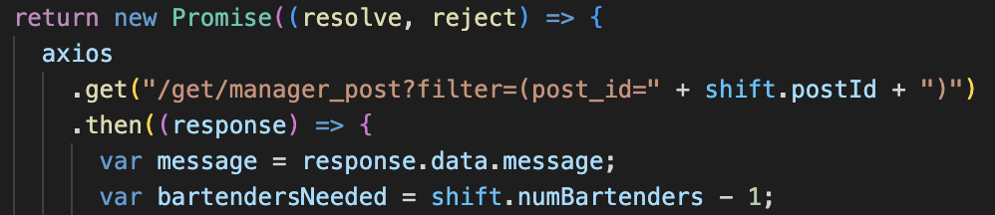
Challenges
Hooks
useState
useEffect
useRef
A LOT of learning
___
Promises
Api Requests
Resolve or Reject?
API Keys
Trying to test OpenCage
Running out of free requests

Slide 18
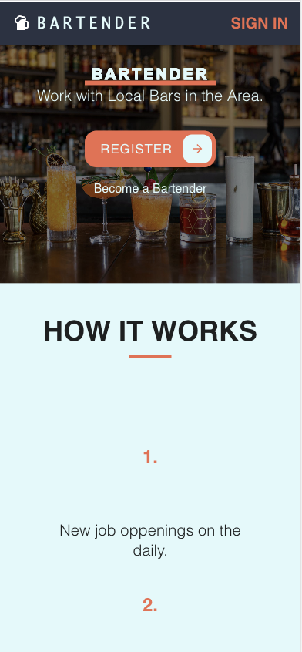
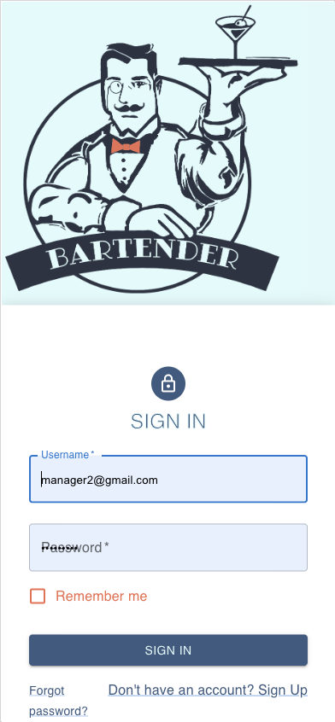
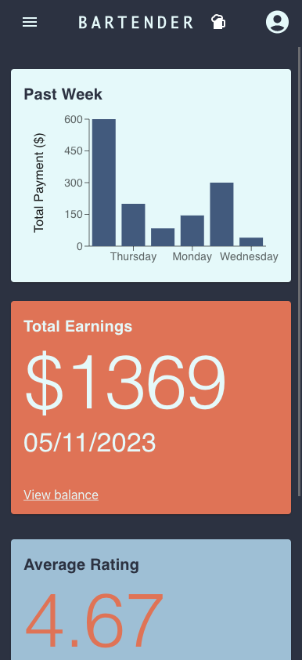
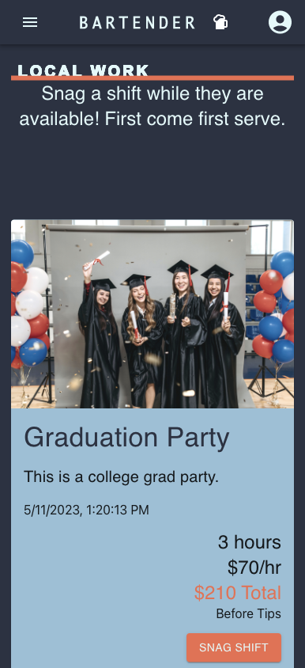
Challenges
Mobile Friendly Website
CSS
___

Slide 19
Business

Slide 20
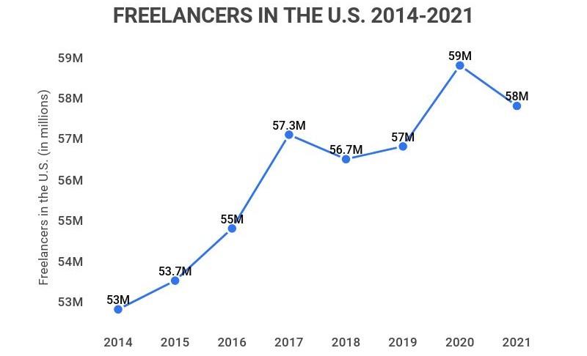
Market
How Many Freelancers Are There In The U.S.? - Zippia
From a McKinsey’s American Opportunity Survey, there has been an increase from 27% in 2016 to 36% currently of Americans who identify as independent or freelance workers. (Freelance work, side hustles, and the gig economy | McKinsey)
Other freelance bartending apps range from job postings on the usual job recruiting sites(ziprecruiter, indeed, etc) to apps similar to ours where bars/restaurants and private events can post shifts and bartenders using the site can pick them up (twistbartendingservice, qwick, etc).

Slide 21
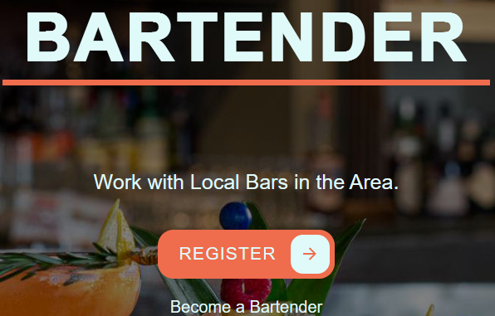
Unique Value Proposition
The reason our web-app separates from the competitors listed on the previous slide is through our accessibility, location services, and targeted focus on one aspect of this market.
Bartender job postings on places like indeed, ziprecruiter, etc. are only a small portion of a massive site filled with postings in almost any job category you can think of.
Sites that are similar to ours either have a pre-set workforce (twistbartendingservice) or cater to the entire restaurant and private event market (qwick) including catering, chefs, busboys, etc.
Our web-app allows any bartender with skills to join the website and begin working while not having to sort through thousands of job postings in which they have no interest in and are nowhere near.

Slide 22

Revenue/Profit
There are a couple of different avenues for an application like ours to generate money.
Monthly/Yearly subscription.
Transaction fee off of each shift taken.
If/when developed into a mobile app: make a download price.
For this type of market that we are targeting, our group would most likely go to a monthly/yearly subscription model for a few reasons:
Gives bartenders incentive to pick up shifts to cover the cost.
Stays away from the negative connotation of the word “fees”

Slide 23
Demo

Slide 24

THANKS!
From the team at BARTENDER
Website Domain: https://bartender.work
Evan Airey aireye@udel.edu
Peyton Leuck pleuck@udel.edu
Calum Siemer calum@udel.edu
Elise Winkley elisew@udel.edu

Slide 25


